Slide 1
English Academic Writing
Advanced
高级英语写作
纪晓丽
jixiaoli@just.edu.cn

Slide 2
Unit 1 Introduction to Academic Writing
参考书目：
Writing Scientific Research Articles M. Cargill & P. O’Connor Wiley Blackwell
美国大学英语写作 John Langan 外语教学与研究出版社
高级英语写作 黑玉琴 西安交通大学出版社
英语写作：毕业论文写作 李正栓 北京大学出版社

Slide 3
Unit One
Definition of Academic writing
Features of academic writing
Main
Contents
Sample of essay
Sample of research paper
Sample of thesis

Slide 4

Definition
What is Academic Writing?
What is Thesis?
What is Research Paper?

Slide 5

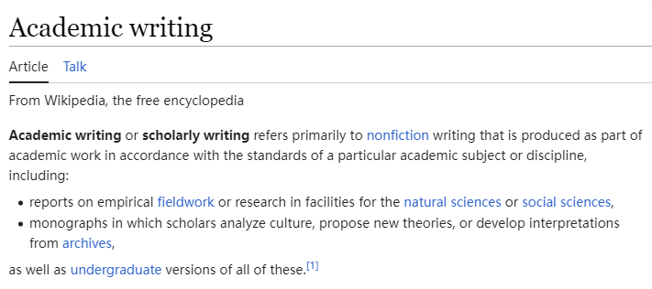


Slide 6

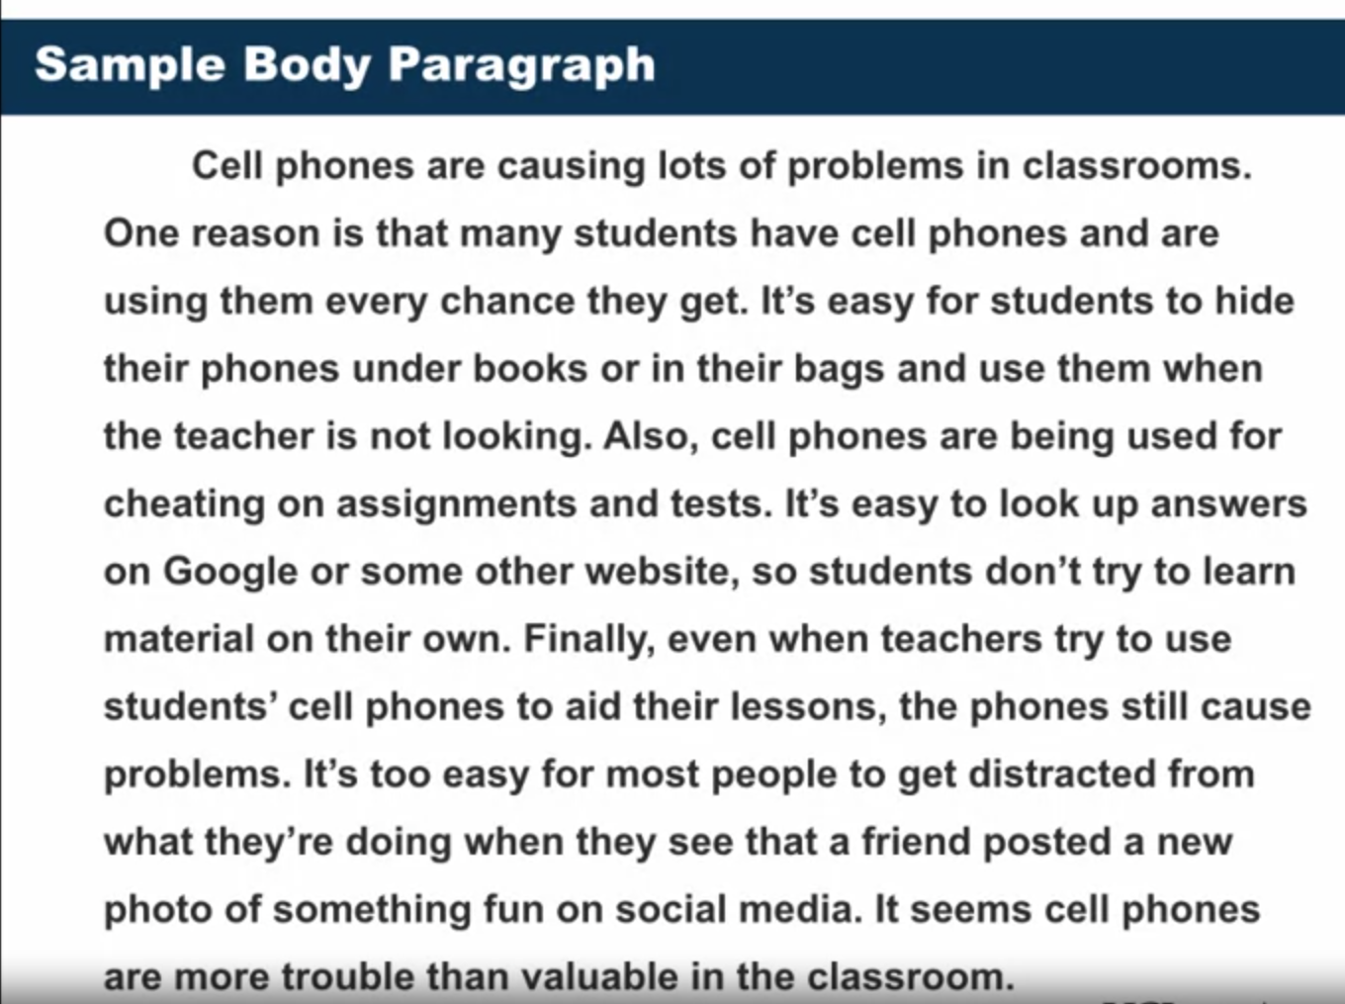

Slide 7


Slide 8

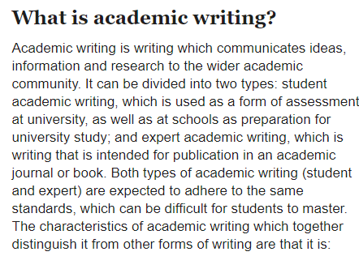
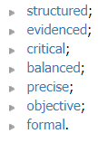

Slide 9

Features
Structured
Academic writing should have a clear structure.
The structure will often derive from the genre of writing.
a report will have an introduction (including the aim or aims), a method section, a discussion section and so on,
an essay will have an introduction (including a thesis statement), clear body paragraphs with topic sentences, and a conclusion.
The writing should be coherent, with logical progression throughout, and cohesive, with the different parts of the writing clearly connected.
Careful planning before writing is essential to ensure that the final product will be well structured, with a clear focus and logical progression of ideas.

Slide 10
Features
Evidenced
Opinions and arguments in academic writing should be supported by evidence.
Often the writing will be based on information from experts in the field,
it will be important to reference the information appropriately
the use of in-text citations and a reference section.

Slide 11
Features
Critical
Academic writing does more than just describe.
As an academic writer, you should not simply accept everything you read as fact.
You need to analyze and evaluate the information you are writing about, in other words make judgements about it, before you decide whether and how to integrate it into your own writing.
Critical writing requires a great deal of research in order for the writer to develop a deep enough understanding of the topic to be truly critical about it

Slide 12
Features
Balanced
giving consideration to all sides of the issue and avoiding bias.
As noted above, all research, evidence and arguments can be challenged, and it is important for the academic writer to show their stance on a particular topic, in other words how strong their claims are.
This can be done using hedges, for example phases such as the evidence suggests... or this could be caused by..., or boosters, that is, phrases such as clearly or the research indicates.

Slide 13
Features
Precise
Academic writing should use clear and precise language to ensure the reader understands the meaning.
This includes the use of technical (i.e. subject-specific) vocabulary, which should be used when it conveys the meaning more precisely than a similar non-technical term.
Sometimes such technical vocabulary may need defining, though only if the term is not commonly used by others in the same discipline and will therefore not be readily understood by the reader.

Slide 14
Features
Objective
Academic writing is objective.
The emphasis is placed on the arguments and information, rather than on the writer.
As a result, academic writing tends to use nouns and noun phrases more than verbs and adverbs.
It also tends to use more passive structures, rather than active voice
The water was heated.
I heated the water.

Slide 15
Features
Formal
Finally, academic writing is more formal than everyday writing.
It tends to use longer words and more complex sentences, while avoiding contractions and colloquial or informal words or expressions that might be common in spoken English.
There are words and collocations which are used in academic writing more frequently than in non-academic writing, and researchers have developed lists of these words and phrases to help students of academic English, such as the Academic Word List, the Academic Vocabulary List, and the Academic Collocation List.

Slide 16
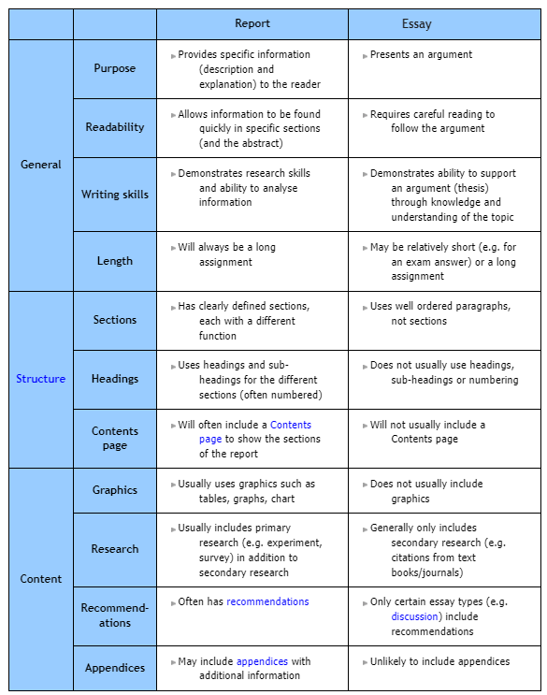
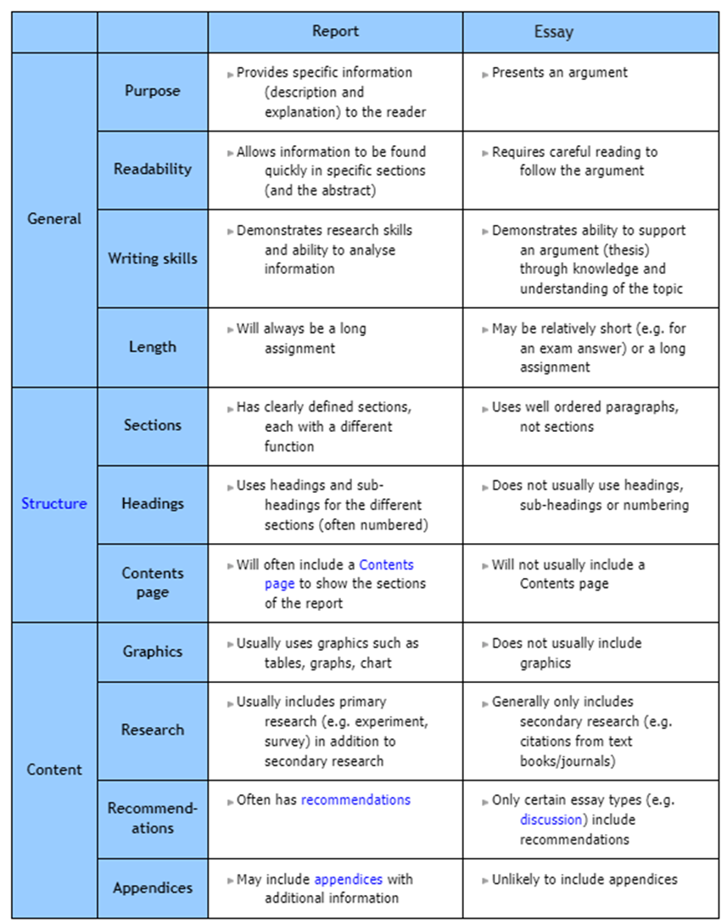

Slide 17
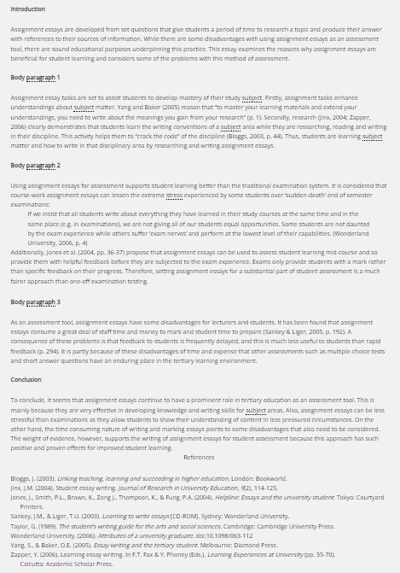
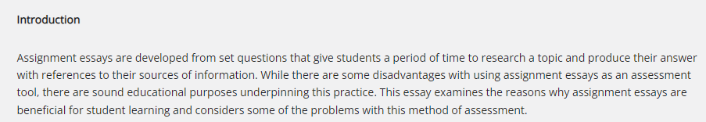
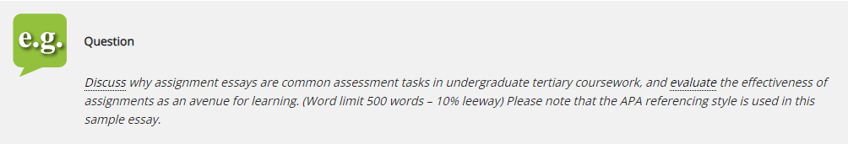
https://aso-resources.une.edu.au/academic-writing-course/sample-essay/

Slide 18
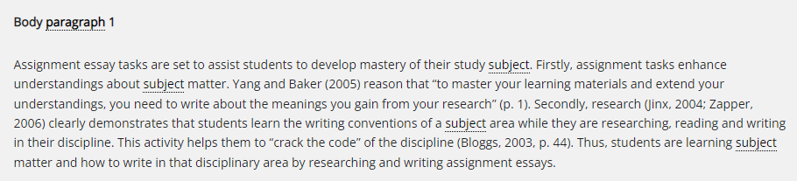
https://aso-resources.une.edu.au/academic-writing-course/sample-essay/

Slide 19
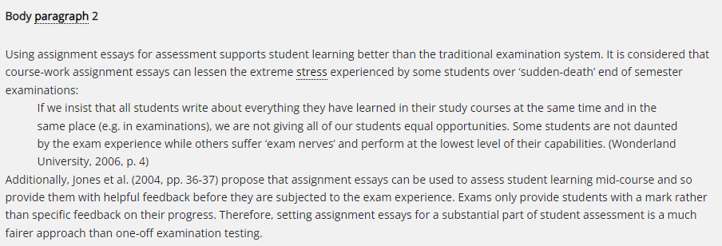
https://aso-resources.une.edu.au/academic-writing-course/sample-essay/

Slide 20
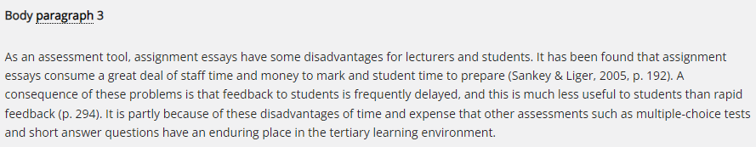
https://aso-resources.une.edu.au/academic-writing-course/sample-essay/

Slide 21
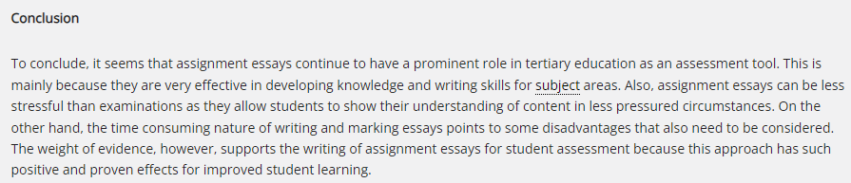
https://aso-resources.une.edu.au/academic-writing-course/sample-essay/

Slide 22
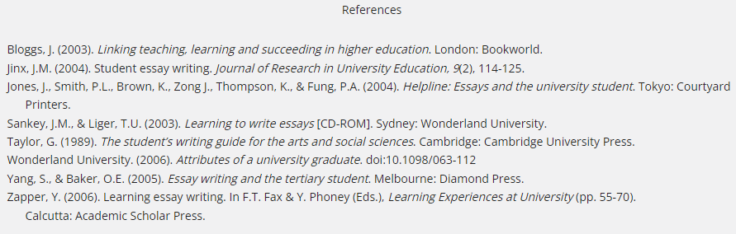
https://aso-resources.une.edu.au/academic-writing-course/sample-essay/

Slide 23
Question:
Discuss why assignment essays are common assessment tasks in undergraduate tertiary coursework, and evaluate the effectiveness of assignments as an avenue for learning. (Word limit 500 words – 10% leeway)
Please note that the APA referencing style is used in this sample essay.
https://aso-resources.une.edu.au/academic-writing-course/sample-essay/

Slide 24
Introduction
Assignment essays are developed from set questions that give students a period of time to research a topic and produce their answer with references to their sources of information.
While there are some disadvantages with using assignment essays as an assessment tool, there are sound educational purposes underpinning this practice.
This essay examines the reasons why assignment essays are beneficial for student learning and considers some of the problems with this method of assessment.
https://aso-resources.une.edu.au/academic-writing-course/sample-essay/

Slide 25
Body paragraph 1
Assignment essay tasks are set to assist students to develop mastery of their study subject.
Firstly, assignment tasks enhance understandings about subject matter. Yang and Baker (2005) reason that “to master your learning materials and extend your understandings, you need to write about the meanings you gain from your research” (p. 1).
Secondly, research (Jinx, 2004; Zapper, 2006) clearly demonstrates that students learn the writing conventions of a subject area while they are researching, reading and writing in their discipline. This activity helps them to “crack the code” of the discipline (Bloggs, 2003, p. 44). Thus, students are learning subject matter and how to write in that disciplinary area by researching and writing assignment essays.
https://aso-resources.une.edu.au/academic-writing-course/sample-essay/

Slide 26
Body paragraph 2
Using assignment essays for assessment supports student learning better than the traditional examination system. It is considered that course-work assignment essays can lessen the extreme stress experienced by some students over ‘sudden-death’ end of semester examinations:
https://aso-resources.une.edu.au/academic-writing-course/sample-essay/

Slide 27
Body paragraph 2
If we insist that all students write about everything they have learned in their study courses at the same time and in the same place (e.g. in examinations), we are not giving all of our students equal opportunities. Some students are not daunted by the exam experience while others suffer ‘exam nerves’ and perform at the lowest level of their capabilities. (Wonderland University, 2006, p. 4)
https://aso-resources.une.edu.au/academic-writing-course/sample-essay/

Slide 28
Body paragraph 2
Additionally, Jones et al. (2004, pp. 36-37) propose that assignment essays can be used to assess student learning mid-course and so provide them with helpful feedback before they are subjected to the exam experience. Exams only provide students with a mark rather than specific feedback on their progress. Therefore, setting assignment essays for a substantial part of student assessment is a much fairer approach than one-off examination testing.
https://aso-resources.une.edu.au/academic-writing-course/sample-essay/

Slide 29
Body paragraph 3
Additionally, Jones et al. (2004, pp. 36-37) propose that assignment essays can be used to assess student learning mid-course and so provide them with helpful feedback before they are subjected to the exam experience. Exams only provide students with a mark rather than specific feedback on their progress. Therefore, setting assignment essays for a substantial part of student assessment is a much fairer approach than one-off examination testing.
https://aso-resources.une.edu.au/academic-writing-course/sample-essay/

Slide 30
Reference
To conclude, it seems that assignment essays continue to have a prominent role in tertiary education as an assessment tool.
This is mainly because they are very effective in developing knowledge and writing skills for subject areas.
Also, assignment essays can be less stressful than examinations as they allow students to show their understanding of content in less pressured circumstances.
On the other hand, the time consuming nature of writing and marking essays points to some disadvantages that also need to be considered.
The weight of evidence, however, supports the writing of assignment essays for student assessment because this approach has such positive and proven effects for improved student learning.
https://aso-resources.une.edu.au/academic-writing-course/sample-essay/

Slide 31
Reference
Bloggs, J. (2003). Linking teaching, learning and succeeding in higher education. London: Bookworld.
Jinx, J.M. (2004). Student essay writing. Journal of Research in University Education, 9(2), 114-125.
Jones, J., Smith, P.L., Brown, K., Zong J., Thompson, K., & Fung, P.A. (2004). Helpline: Essays and the university student. Tokyo: Courtyard Printers.
Sankey, J.M., & Liger, T.U. (2003). Learning to write essays [CD-ROM]. Sydney: Wonderland University.
Taylor, G. (1989). The student’s writing guide for the arts and social sciences. Cambridge: Cambridge University Press.
Wonderland University. (2006). Attributes of a university graduate. doi:10.1098/063-112
Yang, S., & Baker, O.E. (2005). Essay writing and the tertiary student. Melbourne: Diamond Press.
Zapper, Y. (2006). Learning essay writing. In F.T. Fax & Y. Phoney (Eds.), Learning Experiences at University (pp. 55-70). Calcutta: Academic Scholar Press.
https://aso-resources.une.edu.au/academic-writing-course/sample-essay/

Slide 33
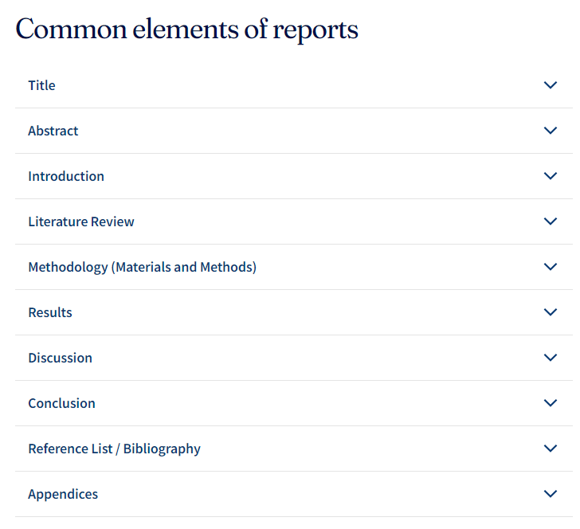

Slide 34
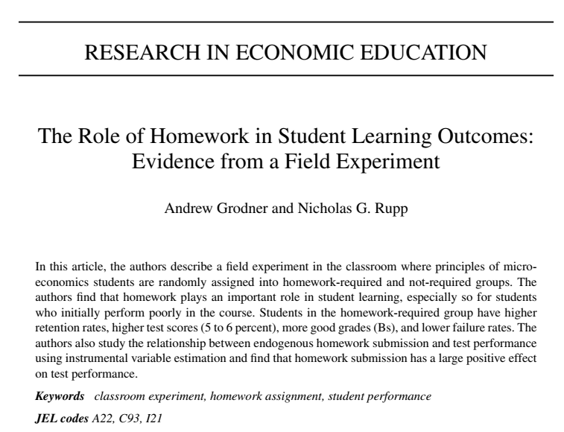

Slide 35
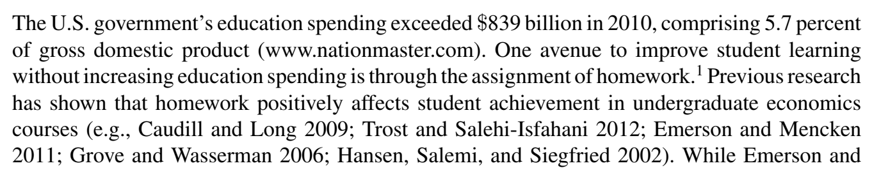
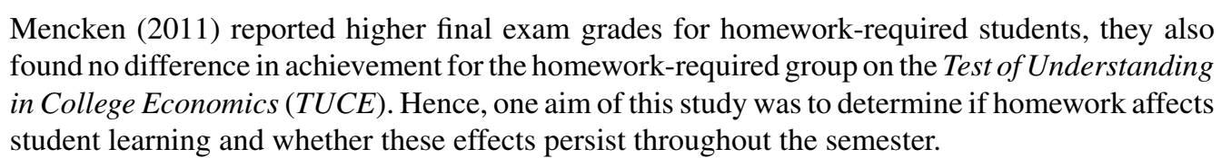

Slide 36
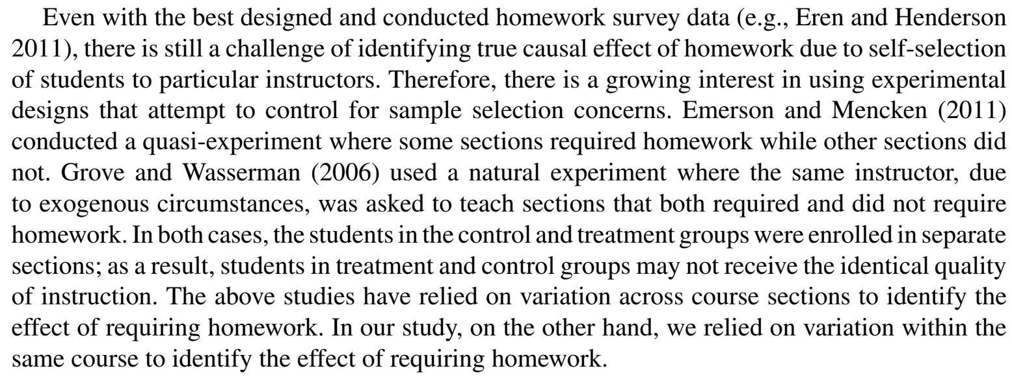

Slide 37
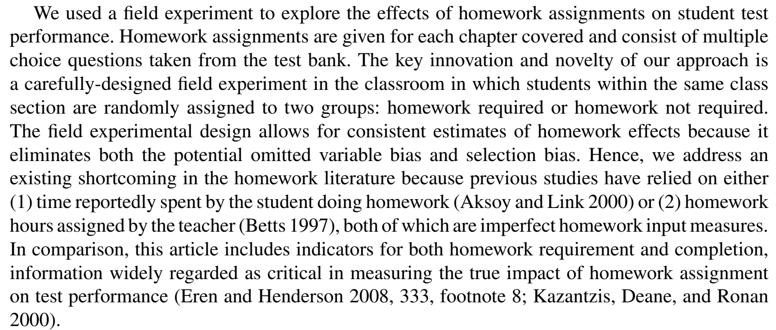

Slide 38
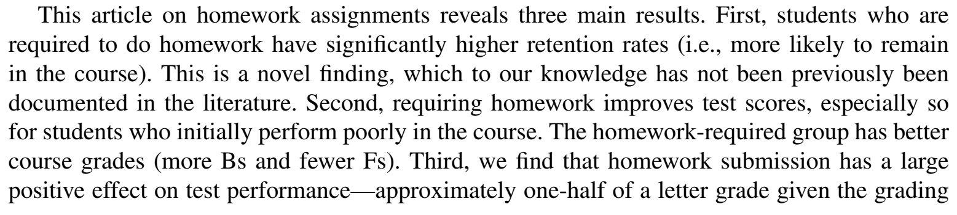

Slide 39
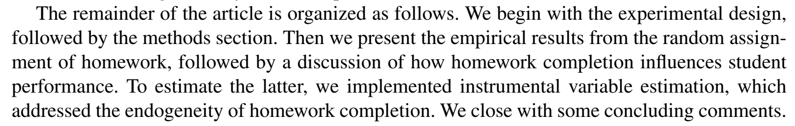

Slide 40

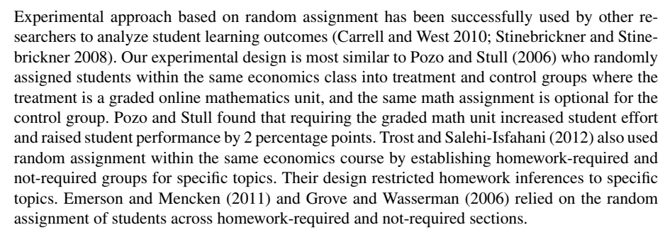

Slide 41
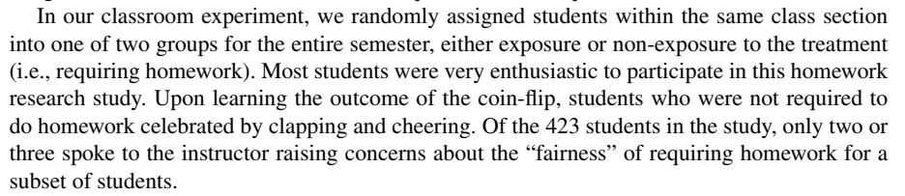

Slide 42
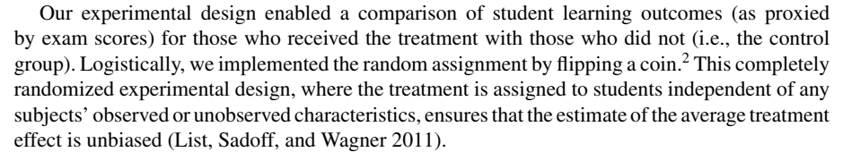
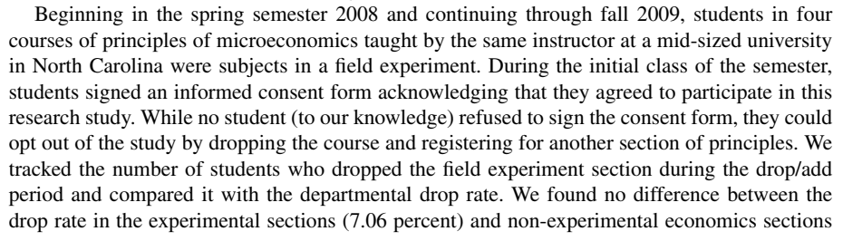

Slide 43
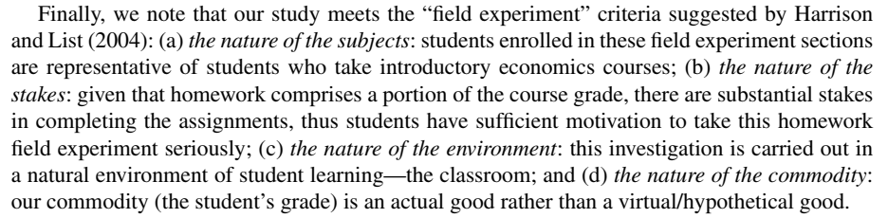

Slide 44

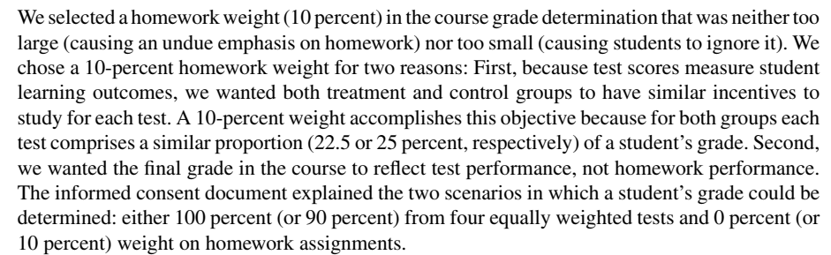

Slide 45
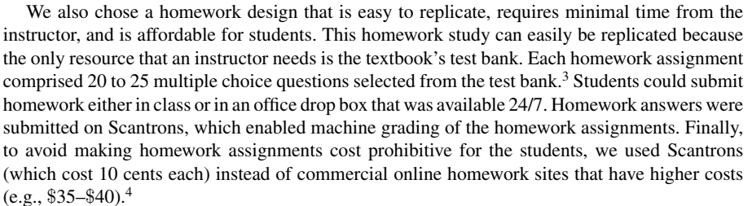

Slide 47
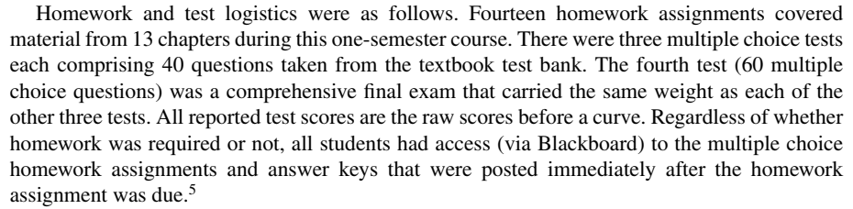

Slide 48
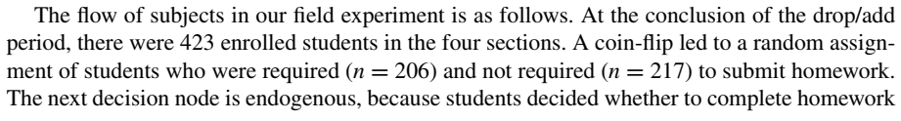
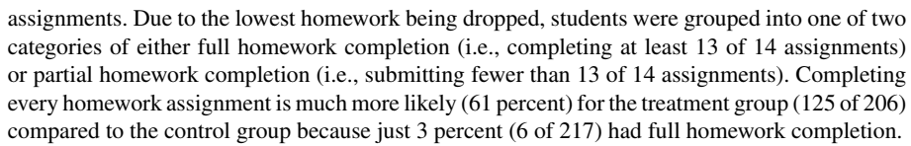
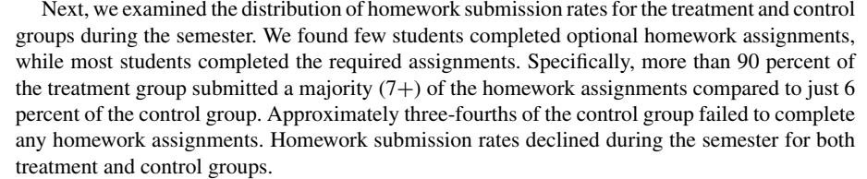

Slide 49
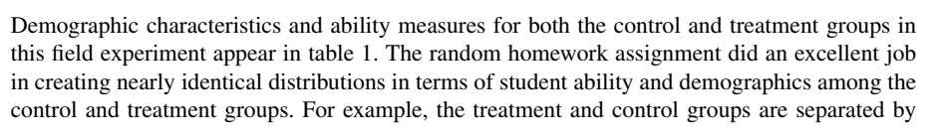
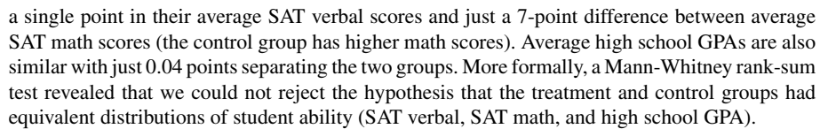

Slide 50
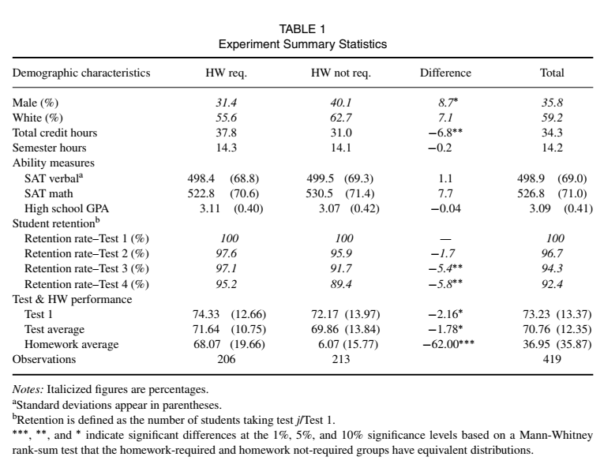

Slide 51
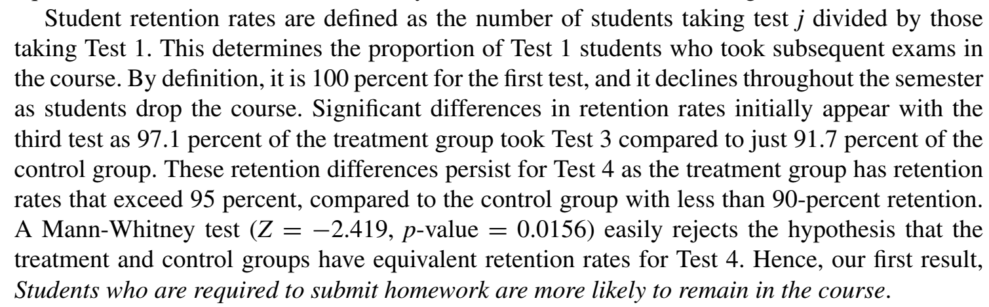

Slide 52
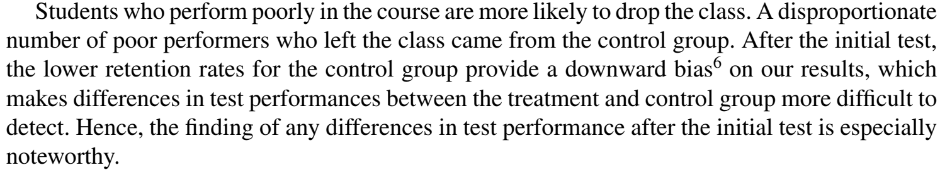

Slide 53

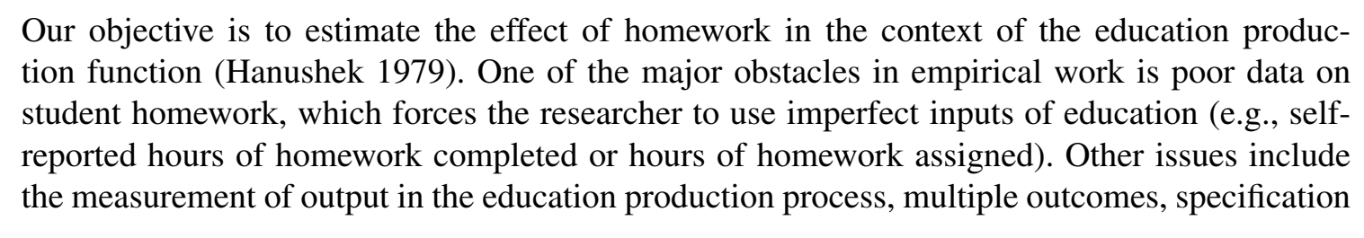
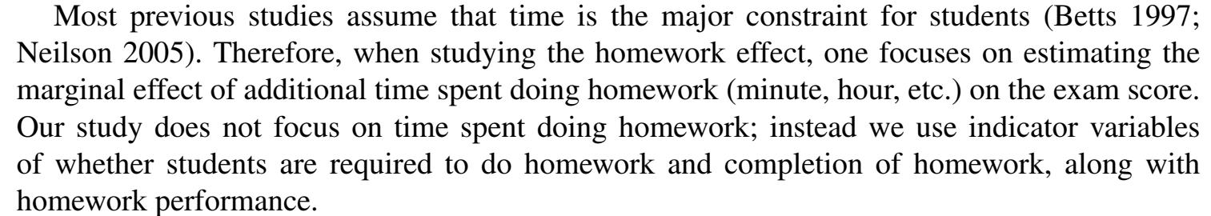

Slide 54

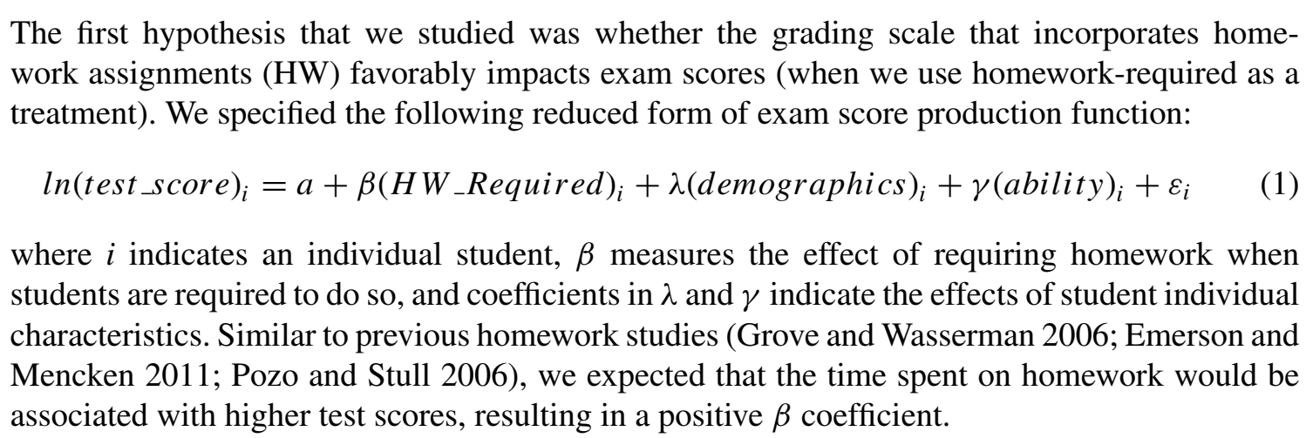

Slide 55
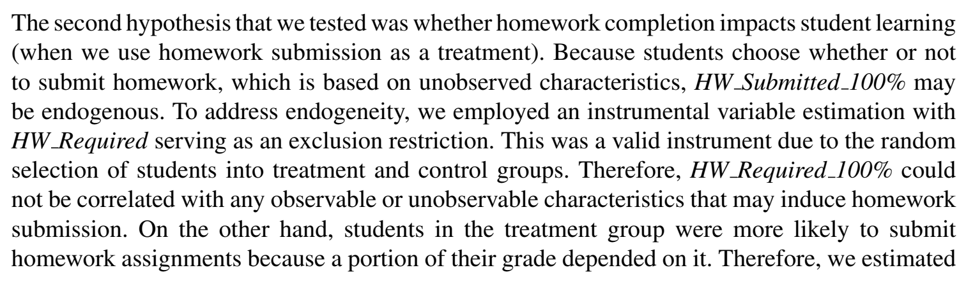
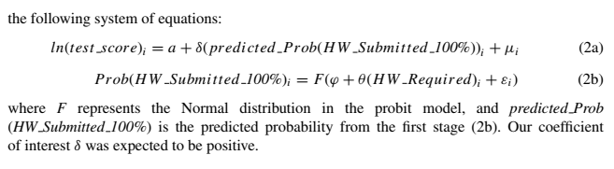

Slide 56

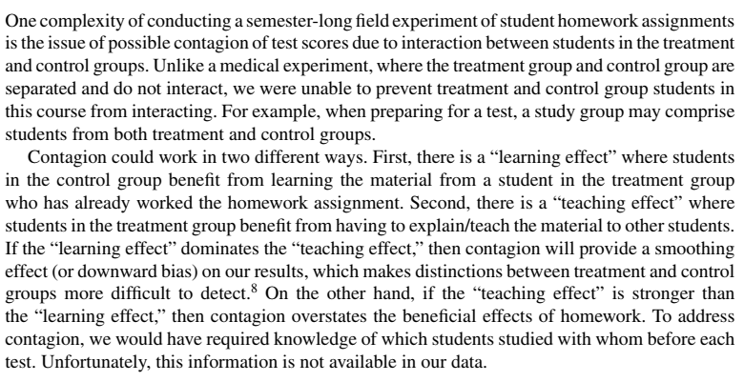

Slide 57





Slide 58
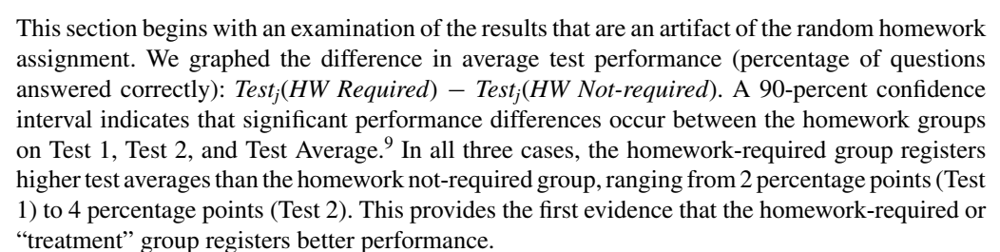

Slide 59
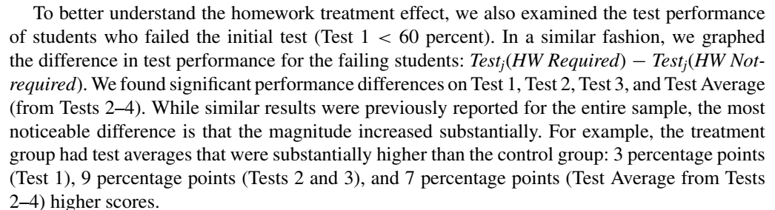

Slide 60
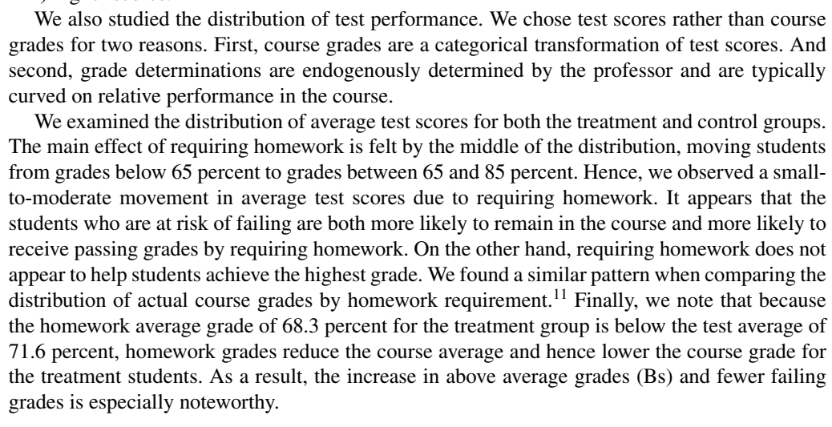

Slide 61

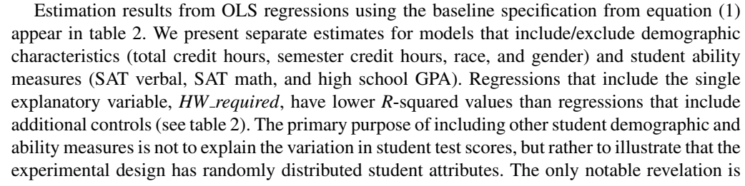

Slide 62
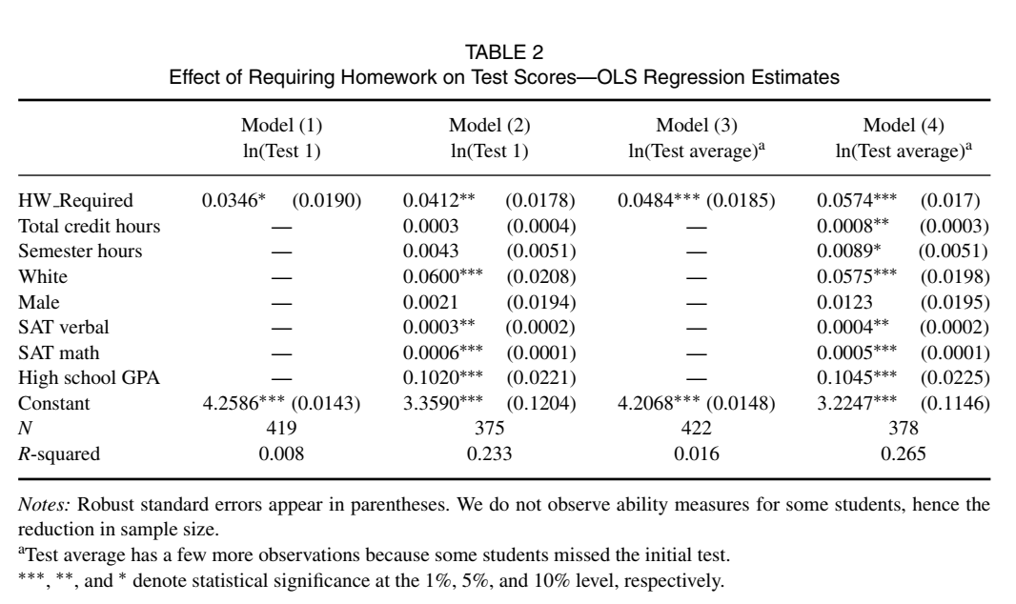

Slide 63
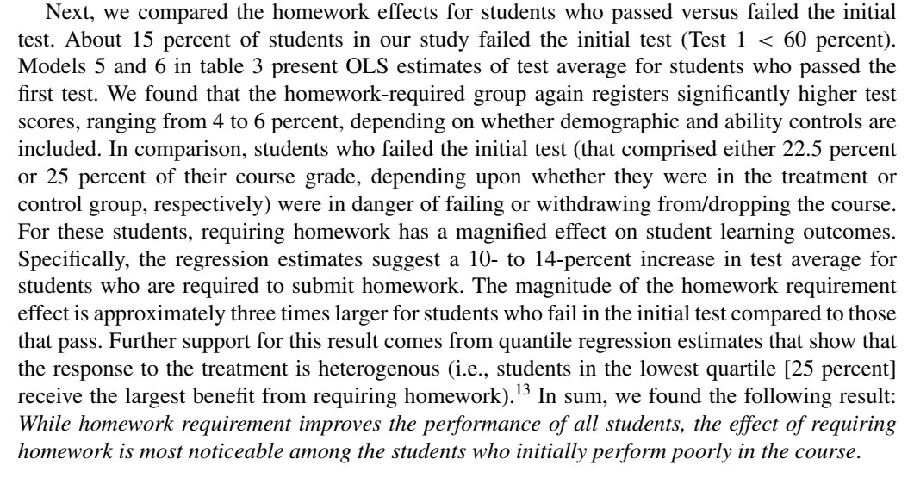

Slide 64


Slide 65



Slide 66


Slide 67


Slide 68



Slide 69



Slide 70


Slide 71


Slide 72


Slide 73



Slide 74


Slide 75


Slide 76


Slide 77


Slide 78


Slide 79
Rule 1
Use formal vocabulary, such as words from the academic wordlist (AWL), and words for numbers up to ten. Avoid less formal or idiomatic vocabulary.
Many fathers nowadays...
Many dads these days...
Major urban centres, such as London and Beijing...
Major urban centres, like London and Beijing...
There are a significant number of people who believe...
There are lots of people who believe...
There are three main reasons for this.
There are 3 main reasons for this.

Slide 80
Rule 2
Use formal verbs instead of two-word verbs.
go up, go down talk about, get better, get worse, go on, bring up
✗ go up, go down, talk about, get better, get worse, go on, bring up
increase, decrease, discuss, improve, deteriorate, continue, raise
Rule 3
Use the full form of verbs, not contractions.
don't, can't, won't, didn't
do not, cannot, will not, did not

Slide 81
Rule 4
Use formal grammar structures, such as nominalisation (noun phrases) and clauses, rather than too many simple sentences.
✓ The increasing pollution of the environment is a global concern.
✗ The environment is increasingly polluted. This is a global concern.
✓ Note-taking, which is an important skill for EAP students, is difficult to master.
✗ Note-taking is an important skill for EAP students. It is difficult to master.

Slide 82
Rule 5
Use statements. Avoid rhetorical questions, which are less formal (though these are common in spoken academic English, i.e. lectures and presentations).
✓ There were four main reasons for the decline.
✗ What were the reasons for the decline?
✓ Written English is different from spoken English.
✗ How are written and spoken English different?

Slide 83
Rule 6
Use impersonal language, such as 'There is...', 'It is...', or passive voice. Avoid personal pronouns (I, we, you, etc.) and adverbs which show your feeling (e.g. luckily, remarkably, amazingly).
✓There are three main problems.
✗I can think of three main problems.
✓ In the experiment, the water was heated...
✗ In the experiment, I heated the water...
✓ There were very few errors in the experiment.
✗ Amazingly there were very few errors in the experiment.

Slide 84
Rule 7
Be as precise as possible. Use exact figures or values wherever possible, rather than 'about' or 'several'. Use words such as 'factor', 'issue', 'topic', 'aspect' instead of vague words such as 'thing'.
✓ There are three main reasons for this.
✗ There are several reasons for this.
✓ The turning point was in the late 1980s.
✗ The turning point was about 30 years ago.
✓ There were three factors which led to this result.
✗ There were three things which led to this result.

Slide 85
Rule 8
Be sure to cite your sources. Avoid making vague claims.
✓ Russell (2001) states that over 50% of the population are unaware of the problem.
✗ Everybody knows that most people are unaware of the problem.
✗ Most people are unaware of the problem.

Slide 86
Rule 9
Use hedging (i.e. tentative language), such as 'possibly', 'probably', 'may', 'might', 'appears to', and 'seems to' to qualify statements. Avoid absolute statements and words such as 'always'.
✓ Education may reduce crime.
✓ It appears that education reduces crime.
✗ Education reduces crime.
✓ This is possibly caused by the effects of global warming.
✓ This may be caused by the effects of global warming.
✗ This is caused by the effects of global warming.
✓ ESL students often make mistakes with tenses.
✗ ESL students always make mistakes with tenses.

Slide 87
Rule 10
Use appropriate transition signals to make explicit (i.e. clear) links between ideas and to introduce new sections of an essay. Avoid numbering or bullet points (except in certain reports), and basic transitions to begin sentences (e.g. 'And', 'But', 'So'). Also be careful not to use too many transitions (not at the beginning of every sentence!).
✓ Turning to the question of inflation...
✗ 2. Inflation.
✓ In addition, inflation is an important factor.
✗ And inflation is an important factor.

Slide 88



Notes:
Steps: www.dglearning.com/en/course.htm 13:21 12-08-09
88

